Slide 1


Marcy Esbjerg, MPA
Senior Program Administrator
Office of Disaster Recovery Resources

Slide 2
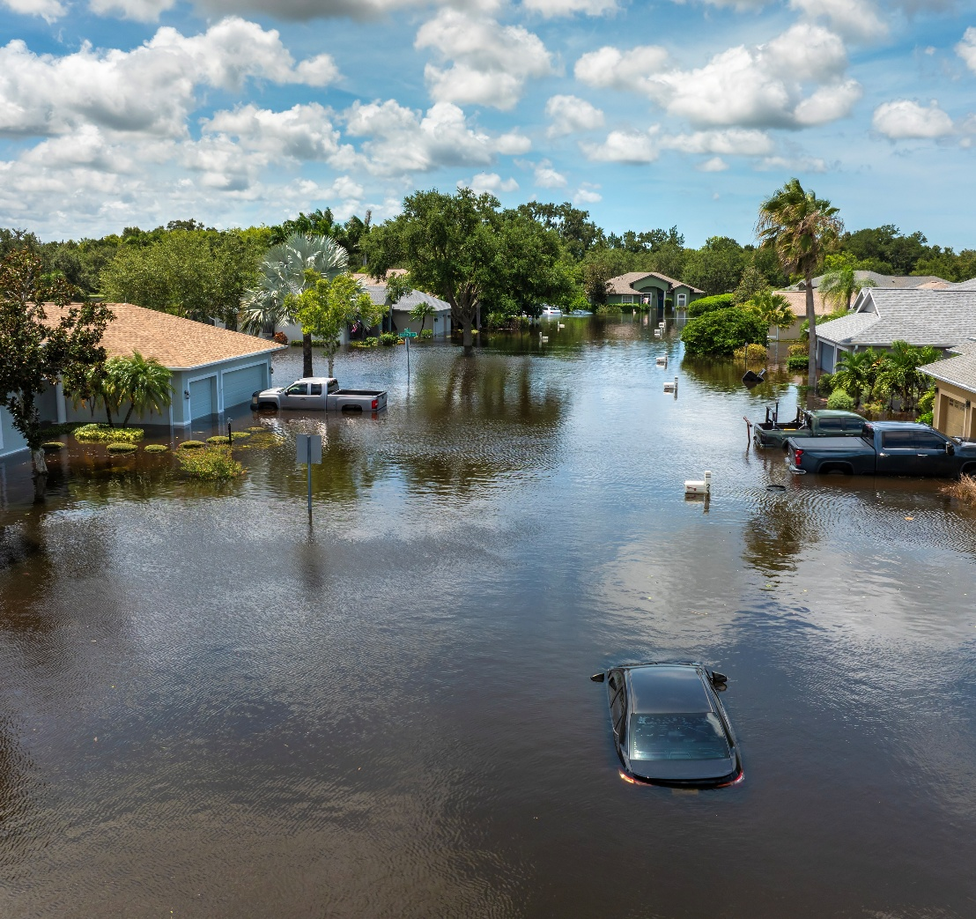
Impact Overview
Hurricanes Idalia (August 2023), Helene (September 2024), and Milton (October 2024) significantly impacted Pasco County:
Over 800 homes destroyed and 7,600 homes with major damage
Thousands of families and businesses were affected, requiring rescues and long-term recovery efforts

Slide 3
Introduction to CDBG-DR
Community Development Block Grant – Disaster Recovery (CDBG-DR) is federal funding from the U.S. Department of Housing and Urban Development (HUD) to help communities recover from disasters.
In January 2025, HUD announced Pasco County will receive a CDBG-DR allocation of $585 million to help recovery efforts from impacts of Hurricanes Idalia, Helene, and Milton.
  Appropriated by Congress – Disaster Relief Supplemental Appropriations Act of 2025
  Universal Notice 90 FR 1754
  Memorandum 2025-02 – revised sections to conform with Executive Orders
Addressing long-term needs that other aid (FEMA, insurance, etc.) didn’t cover.
Direct allocation to Entitlement communities
  >$500M – work with HUD’s Office of Disaster Recovery
  <$500M – work with HUD’s field offices

Slide 4






CDBG-DR Program Basics
Eligible Uses
Key Spending Requirements
70% of total grant funding must benefit low-and moderate-income (LMI) households or areas.
Must meet one of HUD’s three national objectives:
    Benefit LMI
    Eliminate blight
    Address an urgent need
Must address a direct or indirect impact from Hurricanes Idalia, Helene, or Milton.
Must address an unmet need with no alternative funding source identified.
Housing
Infrastructure
Economic
Mitigation
Public Services
Planning

Slide 5
Draft Action Plan Methodology
CDBG-DR Action Plans include an unmet needs assessment, a mitigation needs assessment, allocation/award caps, funding criteria, protocols for future amendments – and more. 90 days to deliver Action Plan.
Ultimately, determining how to spend our $585 million CDBG-DR allocation is based on three things:
          HUD requirements
          Community feedback
          Unmet needs data

Slide 6
To Consult or Not to Consult?
Consider the capacity of your Entitlement department; other team members from other areas;
Consider your skillset and knowledge of disaster recovery, mitigation, data analysis
Is your municipality already under contract with a consultant?
Can you divide and conquer?

Slide 7
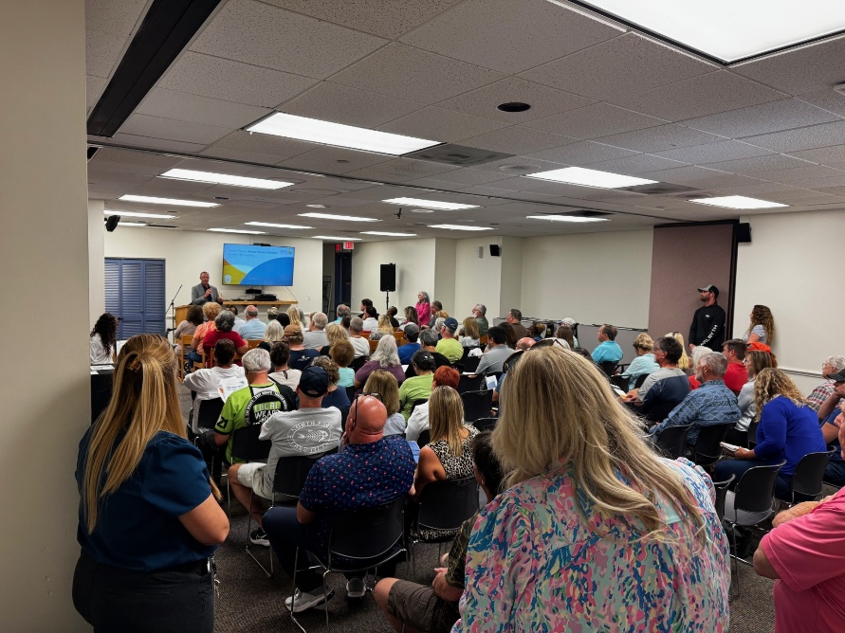
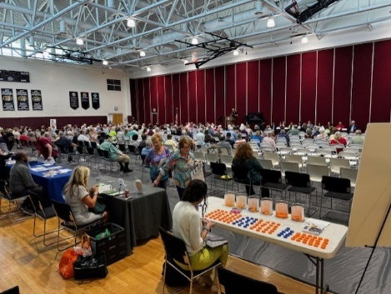
Community Feedback
4 Town halls
3 Public Hearings
Community needs survey
Interactive budget game
Meetings with municipalities
Stakeholder meetings with chambers of commerce, non-profits, etc.

Slide 8
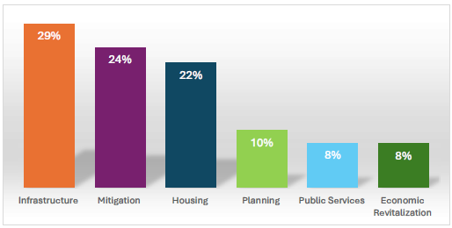
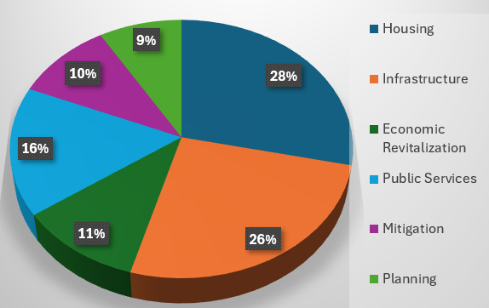
Community Feedback (cont.)
The two CDBG-DR categories that received the most community support were housing and infrastructure.
Community Needs Survey Results
Interactive Budget Game Results
Notes:
Community Needs Survey = over 2,000 respondents, over 1,100 completed.
Budget game = over 1,300 players

Slide 9
Unmet Needs Data
Based on data from FEMA, SBA, HUD, NFIP, Pasco County, and our municipalities:
Unmet needs data focuses on HUD’s three “core aspects of recovery” – housing, infrastructure, economy – rather than CDBG-DR’s six eligible use categories.
“Estimated Impact” numbers are based on insurance claims and FEMA reporting. “Funds Available” are based claims and assistance paid out.
Notes:
Formula is (estimated impact – funds available) X 1.3 …….. We increase 30% to account for resiliency costs and inflation.
Data methodology approaches are similar across the board – we use the same calculations the state of florida are for their allocation – then added specific infra projects identified

Slide 10
Draft Action Plan – Program Allocations
Keeping our programs broad will allow us maximum flexibility to respond to community demand. Not only will we avoid substantial amendments that freeze our funding, but we can reallocate project savings to other projects of similar type.
Category & Programs | Proposed Allocation | % of Allocation
Housing | $305,000,000 | 52%
Repair, Reconstruction, and Elevation (RRE) | $155,000,000
Manufactured Housing Program | $50,000,000
Affordable Housing Construction | $100,000,000
Infrastructure | $130,022,800 | 22%
Critical Infrastructure | $100,022,800
Public Facilities | $30,000,000
Economic Revitalization | $25,000,000 | 4%
Small Business and Non-Profit Recovery | $25,000,000
Public Services | $10,000,000 | 2%
Public Services for a Better Future | $10,000,000
Mitigation | $76,396,000 | 13%
Better Future Match and Mitigation | $76,396,000
Planning | $10,000,000 | 2%
Planning for a Better Future | $10,000,000
Administration | $29,285,200 | 5%
Planning for a Better Future | $29,285,200
Total | $585,704,000 | 100%

Slide 11
Program Specifics - Housing
Program Title: Repair, Reconstruction, and Elevation (RRE)
Program Budget: $155,000,000
Eligible Activities
Reimbursement of disaster recovery expenses for homeowners
Repair, reconstruction, or elevation of single-family owner-occupied housing units
Repair, reconstruction, or elevation of rental housing units
Demolition and clearance of blighted structures
Voluntary buyout and relocation
Program Title: Manufactured Housing Program
Program Budget: $50,000,000
Eligible Activities
Repair, replacement, or elevation of single-family owner-occupied manufactured homes
Reimbursement of disaster recovery expenses for manufactured home unit owners
Demolition and clearance of blighted structures
Voluntary buyout and relocation

Slide 12
Program Specifics - Housing
Program Title: Affordable Housing Construction
Program Budget: $100,000,000
Eligible Activities
Acquisition of real property
New construction of single-family owner-occupied housing units
New construction of rental housing units (1-4 units and 5 or more units)
Demolition and clearance of blighted structures
Voluntary buyout and relocation
Mobile home buyout and redevelopment
Land Trust
Resilient construction ideas

Slide 13
Program Specifics - Infrastructure
Program Title: Critical Infrastructure for Municipalities
Program Budget: $100,022,800
Eligible Activities
Acquisition of real property
Road repairs
Stormwater improvements
Water and wastewater improvements
Dredging
Power resilience
Program Title: Public Facilities for Municipalities/Nonprofits
Program Budget: $30,000,000
Eligible Activities
Acquisition of real property
Improving public facilities including but not limited to community centers, emergency shelters, and transitional housing
Clearance, demolition, rehabilitation, and reconstruction of buildings

Slide 14
Program Specifics – Economic Revitalization and Public Services
Program Title: Small Business and Non-Profit Recovery
Program Budget: $25,000,000
Eligible Activities
Grants or forgivable loans to cover operating expenses during the recovery period such as rent, payroll, utilities, and other costs that the organization struggled to pay due to disaster-related revenue loss.
Machinery, signage, equipment
Repairs for physical damages
Replacement of inventory or supplies
Technical assistance related to recovery
Program Title: Public Services for a Better Future
Program Budget: $10,000,000
Eligible Activities
Case management
Financial literacy
Legal services
Employment and financial recovery services
Homeless services and housing
Food security and basic needs assistance

Slide 15
Program Specifics – Mitigation
Program Title: Better Future Match and Mitigation
Program Budget: $76,396,000
Eligible Activities
Acquisition of real property
Infrastructure improvements
Public facilities improvements
Clearance, demolition, rehabilitation, or reconstruction of buildings
Payment of non-federal share grant match

Slide 16
Program Specifics – Planning and Admin
Program Title: Planning for a Better Future
Program Budget: $10,000,000
Eligible Activities
Preparedness plans, hazard plans, feasibility studies, mitigation studies, local recovery and development plans, capacity building for nonprofits and local governments, innovative construction materials
Program Title: Administration
Program Budget: $29,285,200
Eligible Activities
Costs related to developing, managing, and overseeing CDBG-DR program
All administration costs will be tracked and audited by HUD

Slide 17
Upcoming Timeline
May 12
Publish draft action plan
May 12 – June 12
Community input on draft action plan
June 17
BCC approval of action plan
June 20
HUD approves action plan
September
Receive grant agreement
Winter of 2025 – 2026
Initial programs begin rollout
August
Submit Action Plan to HUD
June 13 – June 15
Finalize draft action plan

Slide 18
Lessons Learned
Be confident in what you know
Don’t be afraid of change
Operate with clear lines of communication
Set and manage expectations – with citizens, with team members and with administration

Slide 19
Thank You!
Marcy Esbjerg
mesbjerg@mypasco.net

